Slide 1
DATA-CENTRIC ROBUSTNESS FOR NLI
Cross-Task Statistical Filtering for Debiasing MNLI
Minhaz Uddin · Istieaque Chowdhury · Antu Chowdhury
Dept. of Computer Science and Engineering, East Delta University

Slide 2
INTRODUCTION
Benchmarks measure the leaderboard,
not always the language
1
GLUE, SNLI, MNLI
“Models are good at
finding shortcuts”
Standard yardsticks the field uses to track NLU progress
2
Shortcuts, not reasoning
Word overlap or class-conditional word distributions that happen to line up with a label — rather than the actual relationship between a premise and a hypothesis.
Models can win on word overlap and label-conditional patterns instead of real entailment
3
The gap this creates
Once a shortcut exists in training data, gradient descent will find it — and the model falls apart on out-of-distribution or adversarial examples.
A high leaderboard score doesn't guarantee the model understood anything
2

Slide 3
OBJECTIVE
Prune the data, not the model
1
2
3
Generalize the statistic
Remove the human step
Run it end to end
Replace the uniform-prior z-statistic with each task's own empirical class prior, so it holds on GLUE's imbalanced tasks
Confirm candidate shortcuts with a cross-task statistical check instead of paid Mechanical Turk annotators
Train real BERT-base checkpoints on original vs. pruned MNLI and evaluate on HANS and SNLI-hard — and report what actually happens
3

Slide 4
MOTIVATION
A model can look excellent and still
fail systematically
A BERT-base model trained the standard way reaches 84% accuracy on MNLI validation — a strong, publishable number. But split that same model's HANS predictions by heuristic and gold label and a very different picture appears.
84.4%
Standard MNLI validation accuracy
(matched + mismatched average)
When lexical overlap is high but the correct label is non-entailment — exactly the case the model needs to get right — it collapses to near-chance. That gap is invisible in the topline metric.
3–9%
Accuracy on the exact HANS subset that matters:
high lexical overlap, gold = non-entailment
4

Slide 5
RESEARCH GAP
Two close efforts, two open gaps
Wang et al. (2022) automate shortcut discovery with BERT attention — but every candidate still needs sign-off from three paid Mechanical Turk annotators.
Paper | Empirical Validation | Data- Centric | Statistical Pruning | Robustness Analysis
Wang et al. 2018 (GLUE) | ✗ | ✗ | ✗ | ✓
Jakubik et al. 2024 | ✗ | ✓ | ✗ | ✗
Wang et al. 2022 | ✓ | ✗ | ✓ | ✓
Wu et al. 2022 | ✓ | ✓ | ✓ | ✓
Proposed Work | ✓ | ✓ | ✓ | ✓
Wu et al. (2022) reject biased examples with a z-statistic — but it assumes a uniform label prior, needs a GPT-2 generator costing 2–3 GPU-days per dataset and was only ever applied to SNLI/MNLI.
5

Slide 6
CONTRIBUTION
What this paper actually adds
1
A data-centric pipeline
Surfaces spurious correlations in GLUE by analyzing training data itself, not the model
2
A generalized z-filter
Uses each task's empirical class prior instead of an assumed uniform one — valid on imbalanced, non-ternary GLUE tasks
3
A human-free verification step
A cross-task stability check replaces Mechanical Turk annotation with a statistic computed from label data
4
An honest, real evaluation
Full BERT-base training and HANS/SNLI-hard evaluation that reports a real trade-off, not a cherry-picked win
6

Slide 7
DATASET DESCRIPTION
The full GLUE suite, MNLI as the
worked example
CoLA · SST-2 · MRPC · STS-B · QQP · MNLI · QNLI · RTE · WNLI + diagnostic set
Dataset Version | Train | Valid (M) | Valid (MM) | Total
Original MNLI | 392,702 | 9,815 | 9,832 | 412,349
Pruned MNLI | 316,925 | 9,815 | 9,832 | 336,572
MNLI and SNLI serve as the worked example throughout: their annotation artifacts are the best documented in prior work and MNLI is the direct comparison point with Wu et al. (2022).
−19%
training pairs removed — all traced to lexical
overlap, the only cross-task-stable feature
Pruned class balance shifts away from uniform
27.9% entailment · 30.8% neutral · 41.3% contradiction
Most of what got removed were entailment-labeled, high-overlap pairs.
7

Slide 8
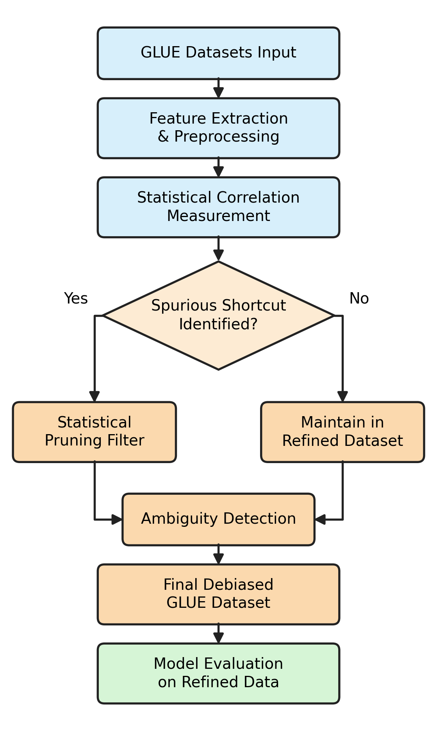
METHODOLOGY · 1 OF 3
The full pipeline
1
Extract task-independent features from every training pair (unigrams, bigrams, length, lexical overlap)
2
Score each feature with the generalized z-statistic against the task's own class prior
3
Confirm candidates with a cross-task stability check instead of human annotation
4
Prune only the confirmed shortcuts — model, loss, and evaluation protocol stay untouched
8

Slide 9
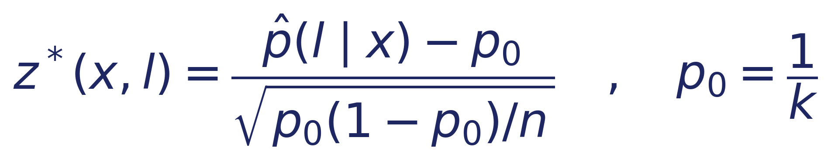
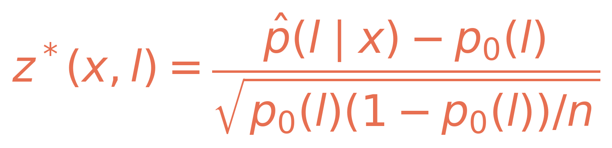
METHODOLOGY · 2 OF 3
Fixing the uniform-prior assumption
Wu et al. (2022) — exact only for balanced 3-way NLI
CoLA splits roughly 70/30. Testing against p₀ = 0.5 would flag ordinary base-rate imbalance as if it were a spurious correlation.
This work — each task's own empirical class prior
Same interpretation. Correct null hypothesis for the task at hand — not an assumed 3-way balance.
9

Slide 10
METHODOLOGY · 3 OF 3
A statistic stands in for the annotator
Wang et al. (2022) send every candidate shortcut to three Mechanical Turk annotators before it counts — the human bottleneck inside an otherwise-automatic pipeline.
0 / 60,063
candidate unigrams and bigrams confirmed
stable across tasks
We compute an equivalent check directly from label statistics: a feature is pruned only if it shows z* ≥ 5 in more than one GLUE task sharing its label family (MNLI, QNLI, RTE).
3 / 9
surface-feature buckets confirmed —
all three lexical-overlap buckets
A feature anomalous in one task but unremarkable elsewhere is more likely domain-specific and genuine — so it's kept.
Length and length-ratio buckets did not pass. Every pruning decision traces back to lexical overlap alone.
10

Slide 11
RESULT ANALYSIS · 1 OF 3
Same model, same hyperparameters,
different training data
bert-base-uncased · 3 epochs · AdamW lr 2e-5 · batch 64 · max length 128 · single T4 GPU · seed 42
The overfitting signal
The original condition improves monotonically — epoch 3 is its best checkpoint.
The pruned condition peaks at epoch 2 (80.77%) and gets worse at epoch 3 (80.12%).
A fixed-epoch protocol would have silently absorbed that into the reported number. We select checkpoints by best validation accuracy instead of last epoch.
11

Slide 12
RESULT ANALYSIS · 2 OF 3
The trade-off, in one chart
MNLI dev
−3.6
in-distribution cost
HANS
+4.6
robustness gain
SNLI-hard
−5.1
unexpected drop
12

Slide 13
RESULT ANALYSIS · 3 OF 3
The HANS topline hides more than it shows
Two heuristics improve a lot.
Subsequence +9.7 pts, Constituent +7.3 pts.
One gets worse.
Lexical overlap drops −3.0 pts — the exact heuristic the pruning targeted.
That contradiction is the seed of the overshoot effect — covered next in Error Analysis.
13

Slide 14
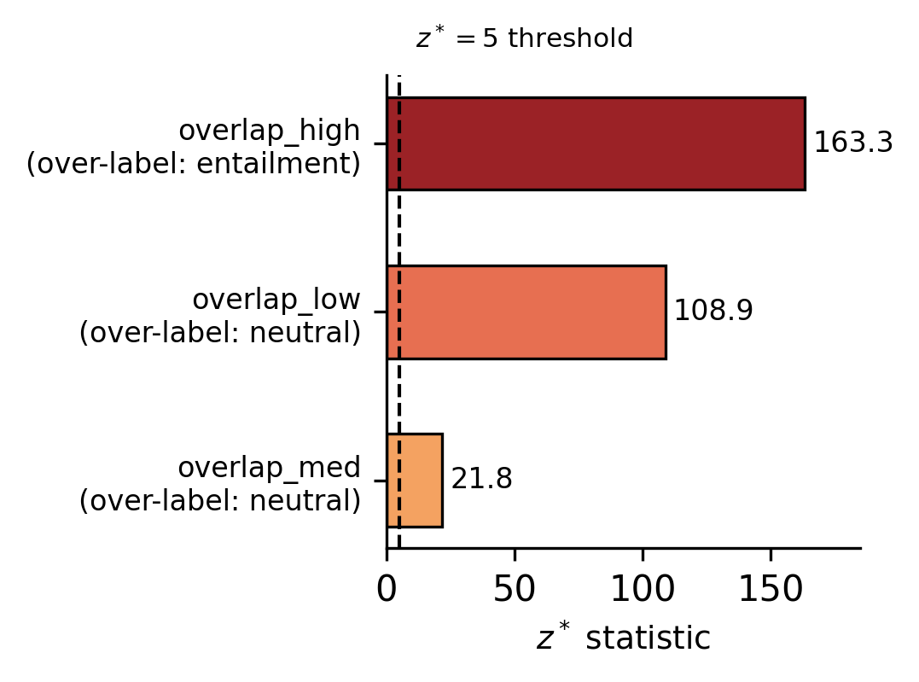
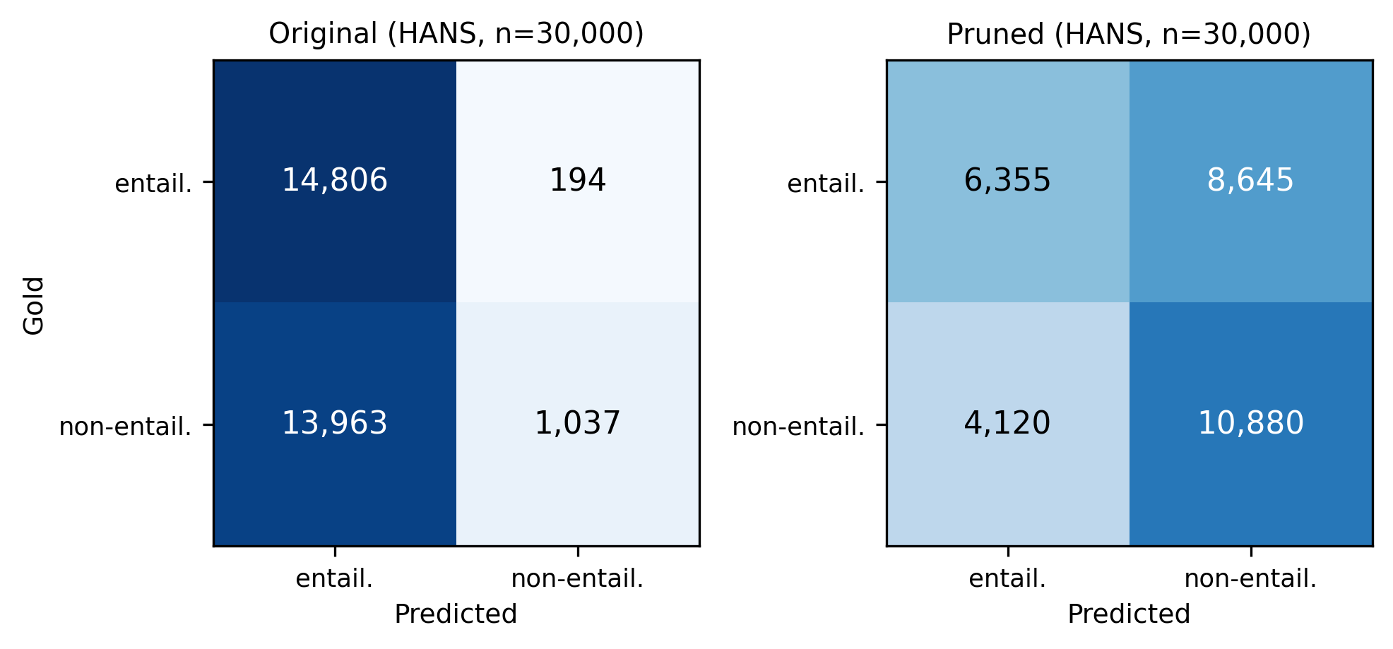
ERROR ANALYSIS · 1 OF 2 · QUANTITATIVE
Why these three features, and what
they actually got wrong
Original
Pruned
P 0.679 · R 0.528
P 0.582 · R 0.574
overlap_high clears the z* ≥ 5 threshold by more than 30×. overlap_med, the weakest of the three, is pruned the least aggressively as a result.
predicts entailment 96% of the time
trades precision for recall, almost 1-for-1
14

Slide 15
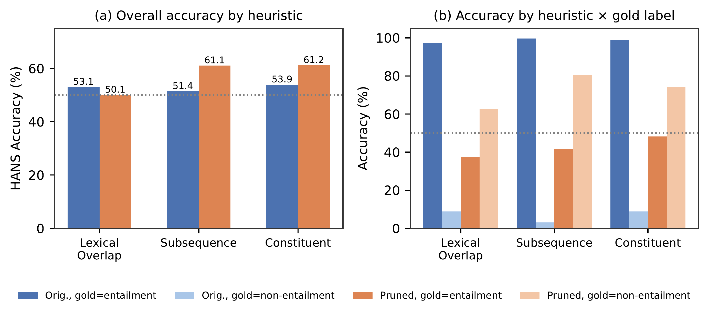
ERROR ANALYSIS · 2 OF 2 · THE OVERSHOOT EFFECT
Pruning fixes the direction, then
overcorrects
Entailment: ~97–100% → 37–48%. Non-entailment: ~3–9% → 63–81%.
CORRECTED — gold: non-entailment
OVERSHOOT — gold: entailment
“The student saw the managers.” → “The managers saw the student.”
Original: entailment (wrong) → Pruned: non-entailment (right)
“The tourist advised the artists who admired the secretaries.” → “The artists admired the secretaries.”
Original: entailment (right) → Pruned: non-entailment (wrong)
15

Slide 16
LIMITATION & FUTURE WORK
What we tested and what's still open
1
Single seed
Variance across seeds could be as large as some effects reported here — multi-seed replication is the priority next step.
2
We tested the obvious fix — it doesn't work
Soft pruning (α = 0.5) keeps MNLI accuracy near baseline (84.11% vs. 84.41%), but HANS falls to 51.86%, below the untouched baseline and the subsequence/constituent gains shrink to +0.03 pts.
3
MNLI only, so far
Feature-set adaptations for CoLA, SST-2, and STS-B are implemented but not yet evaluated end-to-end.
16

Slide 17
CONCLUSION
Pruning data moves HANS from
52.81% to 57.45% — without
touching the model
That gain comes with real costs: a drop on MNLI's own validation set, a drop on SNLI-hard and an overshoot on the very heuristic the pruning targeted. Reporting those costs alongside the gain is more useful than reporting the gain alone.
+4.6
−3.6
−5.1
HANS accuracy
MNLI accuracy
SNLI-hard accuracy
17

Slide 18
Thank You

